Slide 1
Machine Learning Project
Sandhya Cheepurupalli

Slide 2
Problem Statement
Helping an XYZ Environmental Welfare LLP NGO understand the percentage consumption of fuels generating Sulphur dioxide and ash by the US Power Generation organizations.
The goal of the NGO is to focus on organizations using fuels containing higher amounts of sulfur and ash and generate awareness regarding alternatives containing lower residues.

Slide 3
Data description
Sulfur
The lower the amount of sulfur the lesser the amount sulfur dioxide gets generated
Ash
The ash content in fuel indicates the number of inorganic impurities in fuel that can cause various problems along with pollution.
Report date
Comparing data from 2008 t0 2021
Fuel units used
Amount of fuel used by the Energy Generating Organizations to generate power

Slide 4
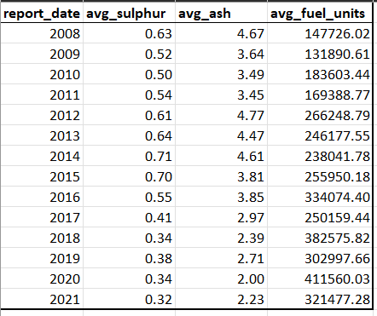
Initial Analysis
Understanding Year-wise fuel usage
The average amount of fuel units used by the power generating companies has increased more than 2 times.
The average sulfur and ash content decreased by half
Since 1993 the US Environmental Protection Agency have been regulating the Sulfur content in fuel.
The agency has revised the standards four times since 1993.

Slide 5
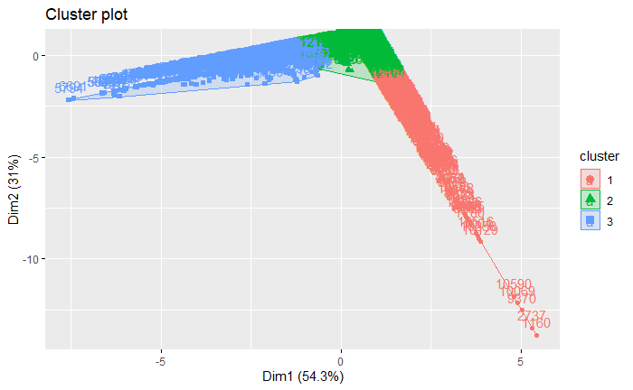
clustering
Methodology used- Kmeans
The Kmeans algorithm has divided data into 3 clusters

Slide 6
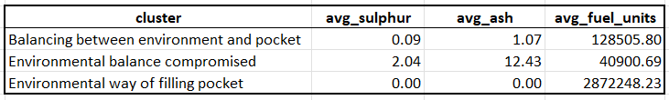
Clustering analysis
Understanding the clustering pattern
Cluster 1- Environmental way of filling pocket – A larger amount of fuel used contained 0sulfurur and 0% ash.
Cluster 2 – Balancing between environment and pocket – A moderate amount of fuel used was containing acceptable levels of sulfur and ash content.
Cluster 3 – Environmental balance compromised – A less amount of fuel is being used by companies which contain more sulfur and ash.

Slide 7
Summary
Over the last 14 years, the consumption of fuel with low sulfur and ash content has increased.
A majority of companies present in the market fall under the category of companies supporting eco-friendly methods of energy production.
Only a 13.4% of total fuel consumed has high amount sulphur and ash.
The NGO needs to generate awareness among a very less percentage of companies to adopt eco-friendly fuel and methods available in the market.

Slide 8
Thank You

